Slide 1



Slide 2
Project Overview
Focus: Addressing customer churn for SyriaTel, a fictitious telecom company.
Challenges: Churn impacts revenue; proactive retention is vital.
Project Objectives
Churn Prediction: Develop models to forecast potential churn.
Model Evaluation: Select the most effective model.
Feature Insights: Identify key factors contributing to churn.

Slide 3
1. Business Understanding
Problems: Predict churn, segment customers, improve service quality, optimize pricing, assess marketing effectiveness.
2. Data Understanding
Source: Customer dataset with usage, subscriptions, and churn info.
Exploration: Understanding feature distribution.
3. Data Preparation
Cleaning: Handle missing values and ensure data consistency.
Feature Engineering: Create new features and encode categorical variables.
Class Imbalance: Use SMOTE for balancing classes.

Slide 4
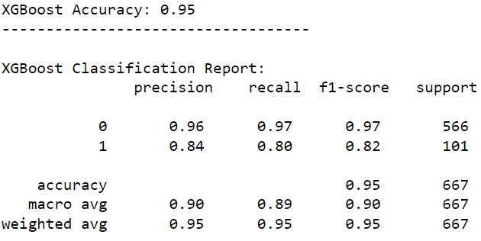
4. Modeling
Models Tested: Logistic Regression, Random Forest, XGBoost, SVM, K-Nearest Neighbors.
Top Performer: XGBoost with 95% accuracy.

Slide 5
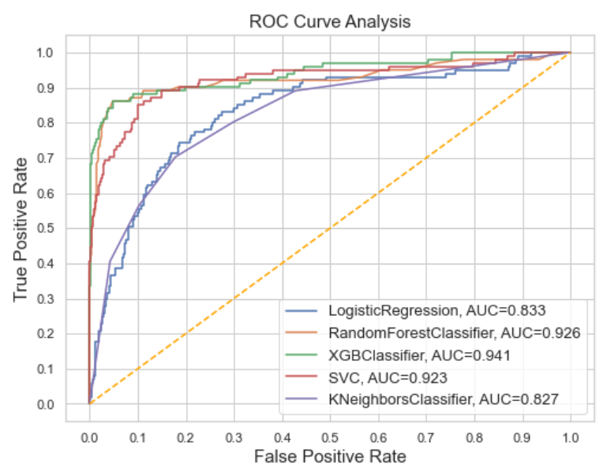
5. Evaluation
Metrics: Accuracy, precision, recall, F1-score,
and AUC-ROC.
Top Models: XGBoost and Random Forest.

Slide 6
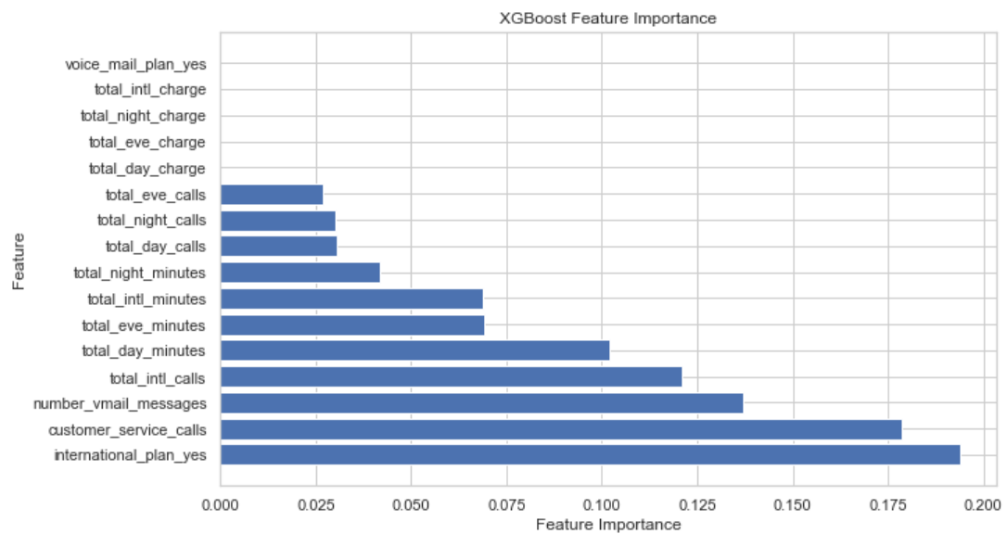
6. Feature Importance

Slide 7
7. Conclusion
Data Prep & Class Balance: Key for accurate churn predictions.
Top Performer: XGBoost with 95% accuracy.
Crucial Features: "international_plan_yes," "customer_service_calls," "number_vmail_messages," "total_intl_calls," "total_day_minutes."

Slide 8
8. Recommendations
- Prioritize International Plans and improve customer service.
- Optimize voicemail usage, address international calls, and enhance service quality.
- Implement proactive XGBoost for churn prediction.
- Segment customers and create targeted retention campaigns.
- Continuously monitor, establish a feedback loop, and assess for reduced churn and growth..

